Slide 1
Virtual Portfolio(rev0)
By Zachary king

Slide 2
What Is my project?

Slide 3
Why I chose this project?

Slide 4
How I developed this project

Slide 5
Who helped me with this project?

Slide 6
Future of my website
Website will always be changing because it is my CS portfolio.
This project has actually made me excited about coding again. However, I’m still not sure what I want to do.
If I could start over, I would forget about that moving particle background.

Slide 7
Next Steps for my project (General)
COMPETELY overhaul the formatting, animations, & theme of the website.
Custom code runner window.
Where/what to host on?
Optimization.
Continue improving

Slide 8
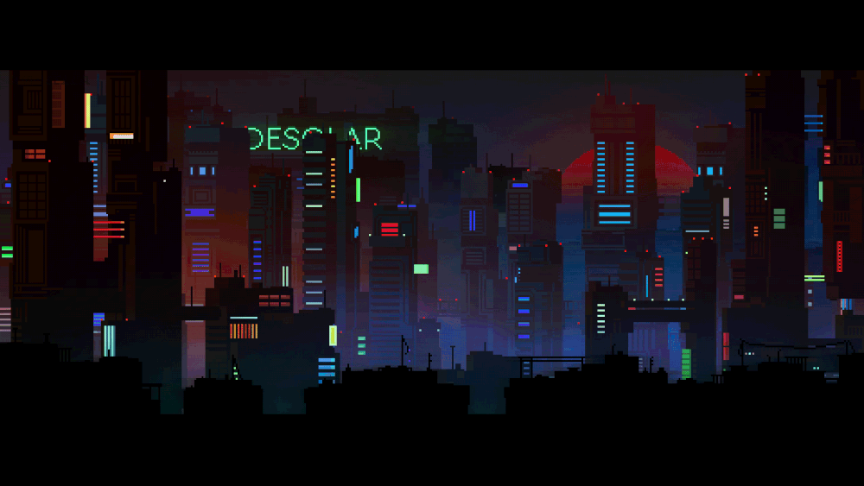
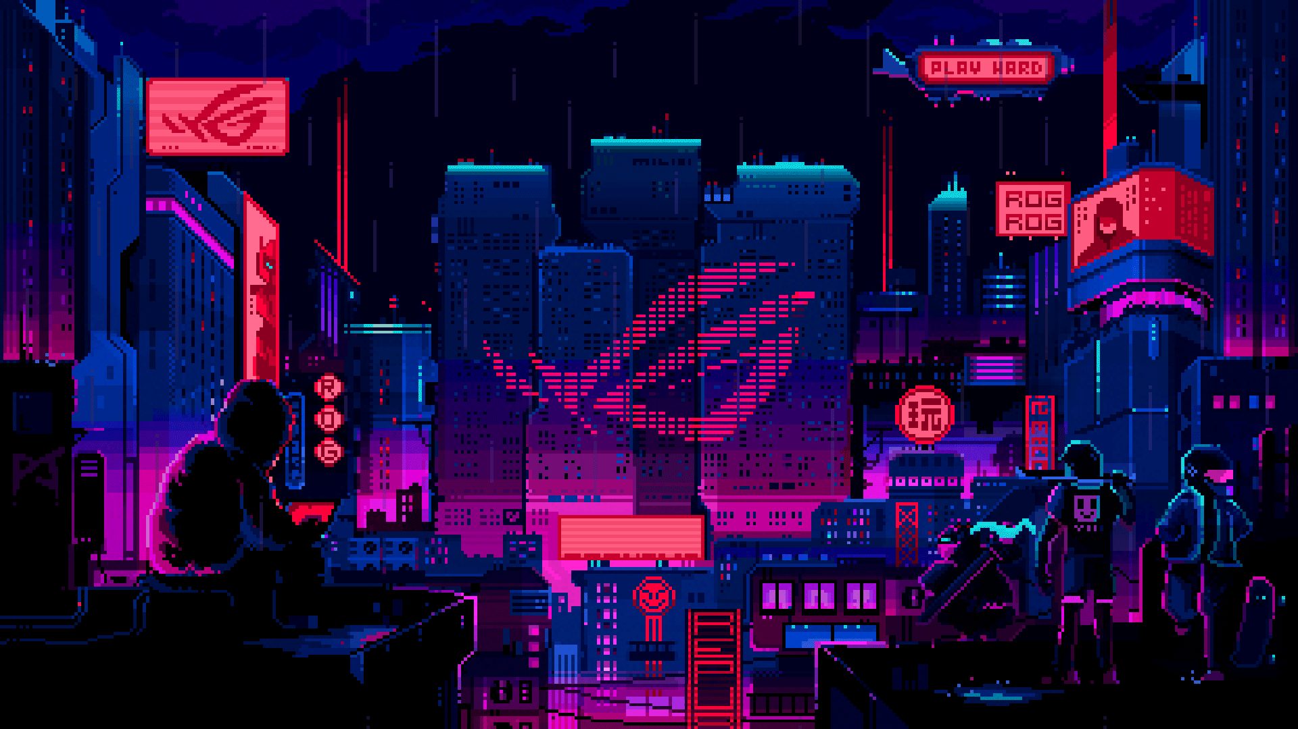
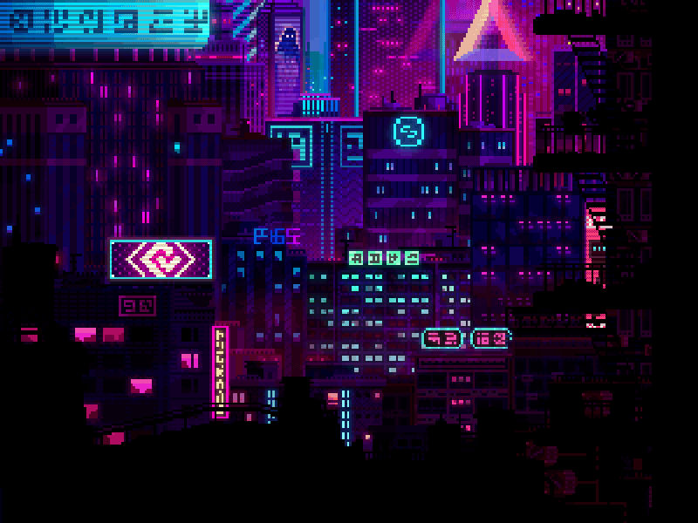
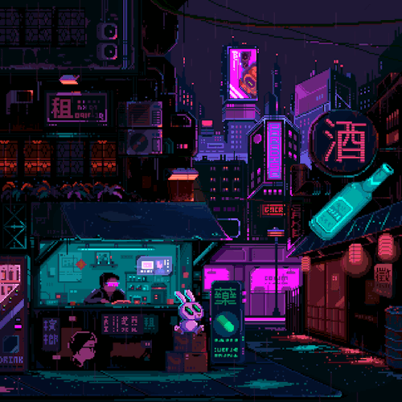
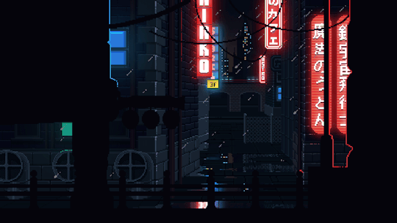
Next Steps (Part 1): Background
Example:
Banner Section:
First Section:
Retro pixel-art style city for the background:
The farther you scroll down, the further you go into the depths of the city.
Each section is its own gif.
Similar to the idea of the levels of the city of Coruscant in Star Wars
Second Section:
Third Section:
Fourth Section:
Fifth Section:
Footer:

Slide 9
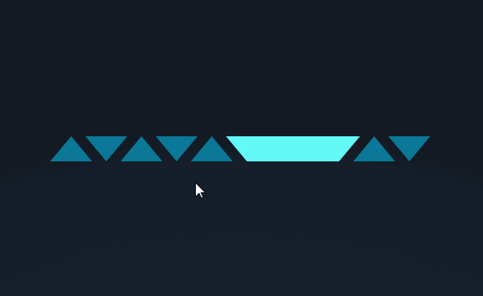
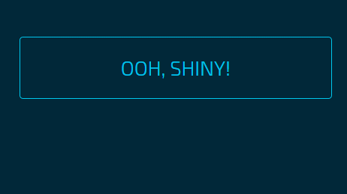

Next Steps (Part 1): Navbar
Add neon highlights
Configure to patch desired format, style, & theme
Color gradients

Slide 10

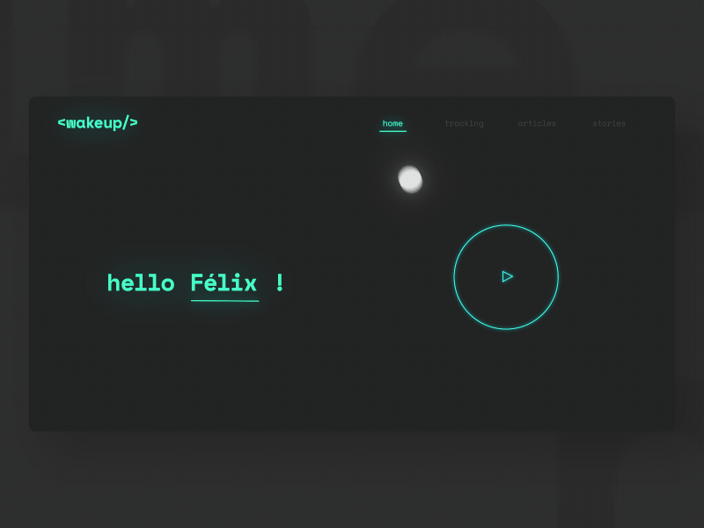

Next steps (part 1): Animations
Add animation to any logical (and tasteful) item.
As long as it enhances the website’s appearance, not hinders it.

Slide 11
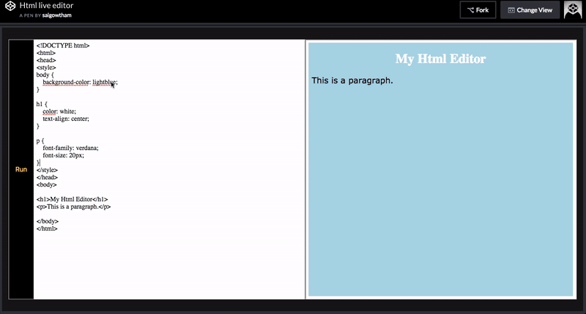
Next Steps (Part 2): Code Runner window
Custom inner windows on my site, allowing me to preload code onto them that showcase some of my CS projects.
Match the theme, formatting, & style
Disables editing (for security reasons)
responsive

Slide 12
Next Steps (Part 3): website host
How to host the website?
Anything from Raspberry Pi – GitLabs & Jekyll
Need to get further to decide which.

Slide 13
Next Steps (part 4): Optimization
Reduce windows load time
(If possible) Place repeated, or “non-essential”, code into separate files to be called as functions.
Lossless compression for gifs & Images.

Slide 14
Next Steps (part 5): Continue Improving
Once next step objectives 1-4 are complete, go through again and find things to improve. Repeat until done.

